Slide 1

Slide 1
Impact of Tesla News and Sentiment
on Stock Price
Team 3
Anjali Hegde
Xema Pathak
Bryan Winowich
Medhaa Bangalore

Slide 2
Slide 2
FACTORS INFLUENCING STOCK PRICE
Supply
News Reports
Demand
Negative News
Positive News
Three News Categories
Bad earnings reports
Good earnings reports
Fundamental
Poor Corporate Governance
Increased Corporate Governance
Technical
Economic and Political Uncertainty
Positive Economic and Political Indicators
Market Sentiment
2

Slide 3
Slide 3
NEWS CATEGORIES DRIVING STOCK PRICES
e
Fundamental
Factors
Technical
Factors
Earnings per Share (EPS)
Price to Earnings Ratio (P/E)
Inflation
Market and Competitor strength
Liquidity of the stock
Market
Sentiment
Subjective, Biased and Obstinate
Investor Demographics
3

Slide 4
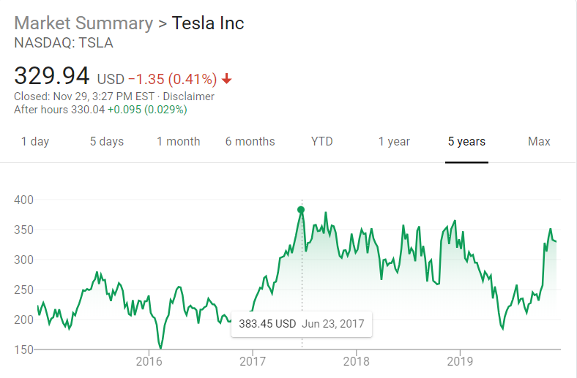
Slide 9
TESLA STOCK TIMELINE
2010
2016
2017
2019
IPO LAUNCHED
LIFETIME LOW
LIFETIME HIGH
LATEST NOTED
STOCK PRICE
$17 / share
$ 160 / share
$ 385 / share
$ 329 / share
4

Slide 5
Slide 12
BUSINESS PROBLEM
Money managers are forever trying to figure out what makes stocks change. A few factors are easy to explain, such as the price gain after a company reports surprisingly strong earnings. But experts are still trying to de-mystify other behaviors.
Do the stock prices change with the sentiment of news?
Is there any impact of what investors are talking about the current news of a company?
Tesla receives its fair share of mention in comments on Reddit and in the news. Analyzing these comments and news pieces and comparing them would provide insights on the movement of stock, thus helping Tesla investors better place their money.
9

Slide 6
Slide 12
HYPOTHESIS
Sentiments of the investors on a company affect the stock prices of that company
9

Slide 7
Slide 12
METHODOLOGY USED
Extraction of data
Investors’ opinions: Reddit comments News
Sentiment analysis
Modeling Linear Regression
9

Slide 8
Slide 12
DATA
Investors’ Sentiment
News’ Sentiment
Reddit comments
‘teslainvestorclub’ subreddit
May to July
Data sourced from Google Big data query
45k+ comments
News articles on Tesla for these 3 months
9k+ news
9

Slide 9
Slide 10
MODELING AND INSIGHTS

Slide 10
Slide 10
What is the Impact of News Sentiment on Stock Prices?
It appears that there is a positive effect of news sentiment on day-to-day price changes
The main takeaway is that the comparative sentiment of the positive/negative/neutral news is far more impactful than just whether the news is positive/negative/neutral
However, this model was not very significant in overall estimation of price changes
Formula: change in stock price =
01.15 + 71.3 (news sentiment) + 0.145(positive news) - 0.136(negative news) + 0.0213(neutral news) - 0.62(positive news * news sentiment) + 6.47(negative news * news sentiment) – 3.17(neutral news * news sentiment)
10

Slide 11
Slide 10
What is the Impact of Comments’ Sentiment on Stock Prices?
A negative comment increases price more than a positive comment, this could indicate people can be more defensive about certain news at times than the market would dictate
The model also shows that the extremely high sentiment comments decrease price.
This model was not significant in estimating price changes so it’s unclear if there’s an effect
Formula: change in stock price =
2.87 – 23 (comments sentiment) + 0.1204(positive comments) + 0.22 negative comments – 0.285(neutral comments) –0.852(positive comments * comment sentiment) – 2.65(negative comments * comment sentiment) + 2.58(neutral comments * comment sentiment)
10

Slide 12
Slide 10
What is the Impact of Relative Sentiment on Stock Prices?
A relationship between relative sentiment
and stock prices could not be established
While this was the best model, it still gave high
P values
Formula: change in stock price =
-1.21 + 117.5 (Comment Sentiment – News Sentiment) + 0.455 (Comment Sentiment – News Sentiment)/(News Sentiment) + 8.71 (News Sentiment – Comment Sentiment)/(Comment Sentiment
10

Slide 13
Slide 10
What is the Change in Volume Traded?
Neutral comments and negative news have the highest impact on volume.
It seems counterintuitive that positive comments would be negative, but this likely just means there are a lot of people defending the company during bad times.
High neutral comments imply that it’s very popular news, meaning more likely to have an actual impact
Formula: change in volume traded =
541806 – 857(Negative News ^2) - 16.85(Positive Comments ^2) + 28 (Neutral Comments ^ 2)
10

Slide 14
Slide 10
The Best Model
Neutral comments and polarity of negative comments have the highest impact on the change in stock price
Interestingly, comments are a much stronger predictor than news
Formula: change in stock price =
-4.55 + 1.029 (Negative comments * Sentiment) – 0.000289 (Negative Comments ^2)
10
Notes:
While there are much more factors that could affect Volume, of the data we had access to, the main conclusion is that Neutral comments and negative news have the highest impact. This seems counterintuitive that positive comments would be negative, but this likely just means there are a lot of people defending the company during bad times. High neutral comments imply that it’s very popular news, meaning more likely to have an actual impact

Slide 15
Slide 12
RECOMMENDATIONS
% of positive comments = 47.65%
% of negative comments = 16.90%
% of neutral comments = 35.45%
We notice that negative sentiments have a bigger role to play in the change in stock price
The number and polarity of the negative sentiment impacts the change
9

Slide 16
Slide 12
LIMITATIONS
TextBlob API was used to extract sentiment polarity; a more advanced model for sentiment analysis such as Microsoft Azure or GCP
The external factors affecting stock prices were not taken into consideration; these factors could be accounted for to build a more robust model
9

Slide 17
Slide 10
THANK YOU

Slide 18
Slide 12
APPENDIX
Variable Name | Calculation
Weighted News | Total News/Max(Total News)
Weighted Comments | Total Comments/(Max(Total Comments)
News*Sent | Weighted News * News Sentiment
Comm*Sent | Weighted Comments * Comment Sentiment
Difference | Comment Sentiment - News Sentiment
Pos News % | Positive News / Total News
Pos comm % | Positive Comments/Total Comments
Neg News % | Negative News / Total News
Neg Comm % | Negative Comments/Total Comments
News Diff | Pos News % - Neg News %
Comm Diff | Pos Comm % - Neg Comm %
Weighted Pos News | Positive News / Max(Total News)
Weighted Neg News | Negative News/ Max(Total News)
Weighted Pos Comm | Positive Comments/Max(Total Comments)
Weighted Neg Comm | Negative Comments / Max(Total Comments)
Sentiment Ratio | Comment Sentiment / Comment Sentiment
NewsSent^2 | News Sentiment squared
CommSent^2 | Comment sentiment squared
News^2 | Weighted news squared
Comm^2 | weighted comments squared
News*Sent^2 | (News*Sent)^2
Comm*Sent^2 | (Comm*Sent)^2
Variable Name | Calculation
Diff^2 | Difference squared
Ratio^2 | Sentiment Ratio squared
NumNews^2 | Total news squared
PosNews^2 | Positive news squared
NegNews^2 | Negative news squared
NeutNews^2 | Neutral news squared
NumComm^2 | Total comments squared
PosComm^2 | Positive comments squared
NegComm^2 | Negative comments squared
NeutComm^2 | neutral comments squared
PosNews%2 | Pos News % ^2
PosComm%2 | Pos comm % ^2
NegNews%2 | Neg News % ^2
NegComm%2 | Neg Comm % ^2
RelativeNews | (comment sentiment - news sentiment) / news sentiment
RelativeComm | (news sentiment - comment sentiment)/comment sentiment
CommNeg | comment sentiment * negative news
CommPos | comment sentiment * positive news
CommNeu | comment sentiment * neutral news
NewsNeg | news sentiment * negative news
NewsPos | news sentiment * positive news
NewsNeu | news sentiment * neutral news
9

Slide 19
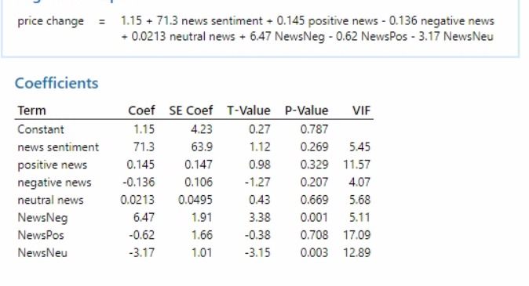
Slide 12
Model 1
9

Slide 20
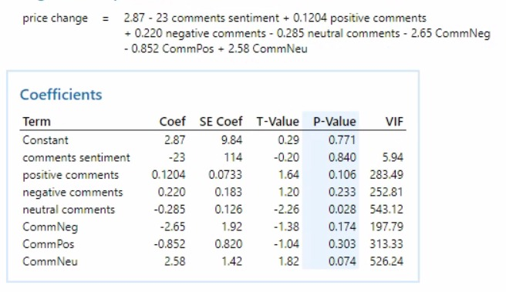
Slide 12
Model 2
9

Slide 21
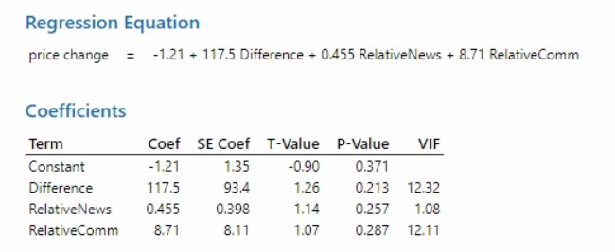
Slide 12
Model 3
9

Slide 22
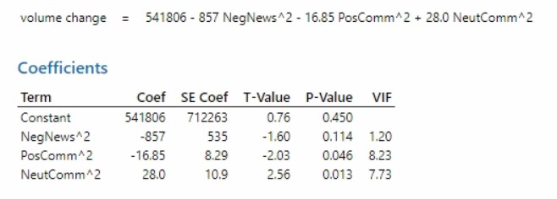
Slide 12
Model 4
9

Slide 23
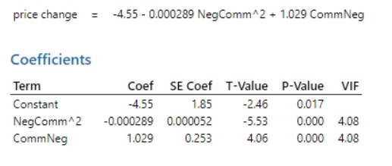
Slide 12
Model 5
9

